Slide 1
Association Rule Learning (Market Basket Analysis)

Slide 2
Outline
Introduction
Association Rule Learning/Market Basket Analysis
Business Applications
Apriori Algorithm
Metrics

Slide 3

Amazon is one of the largest online shopping retailer globally

Slide 4
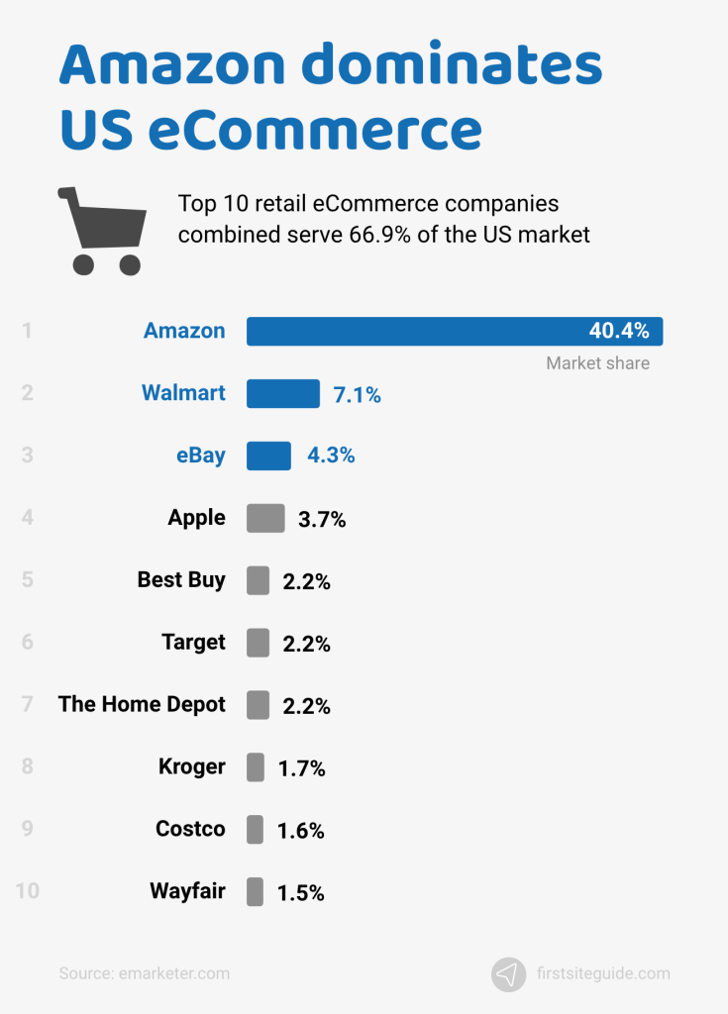
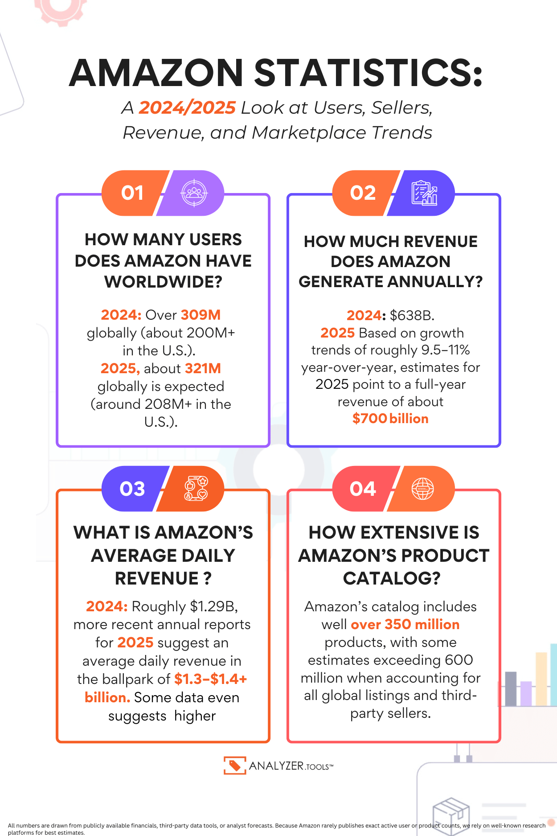
In the US, it holds a 40 percent market share.

Slide 9
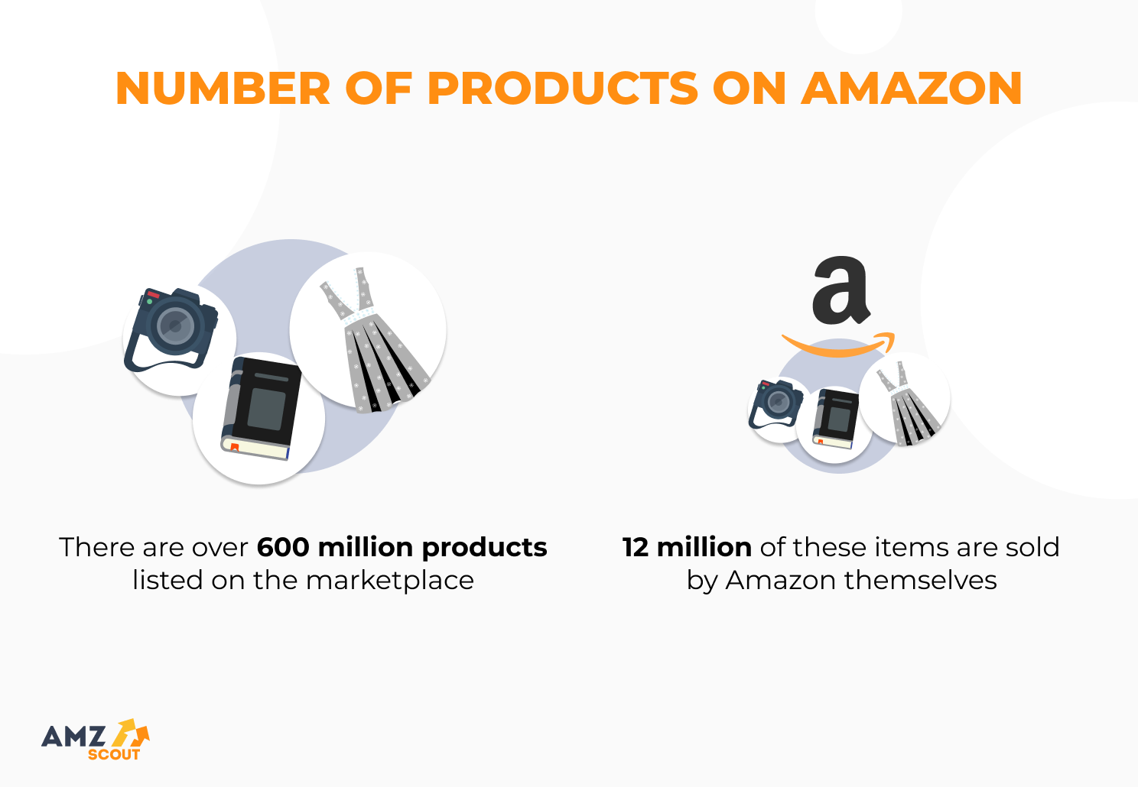
How does amazon sell 600 million products with the highest turnover possible while avoiding having items that sits in inventory for a very long time?

Slide 10
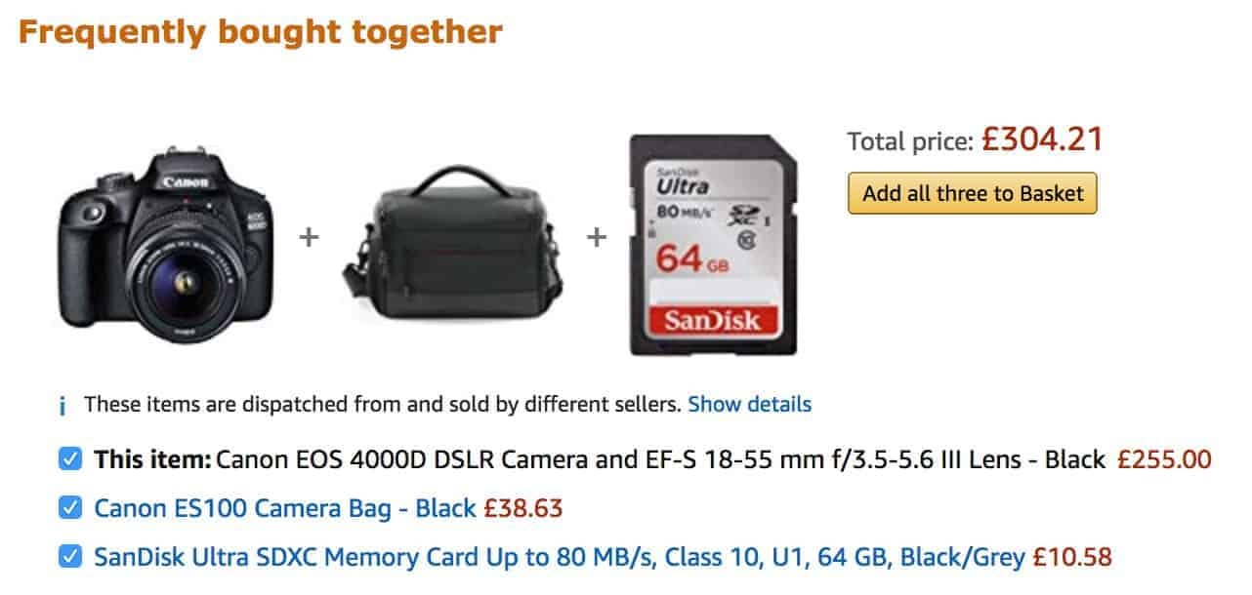
You may have seen this before after buying an item online. For example, if you bought a camera..

Slide 11
Amazon will suggest another item that is frequently bought together with a camera

Slide 12
Amazon will suggest another item that is frequently bought together with a camera

Slide 13
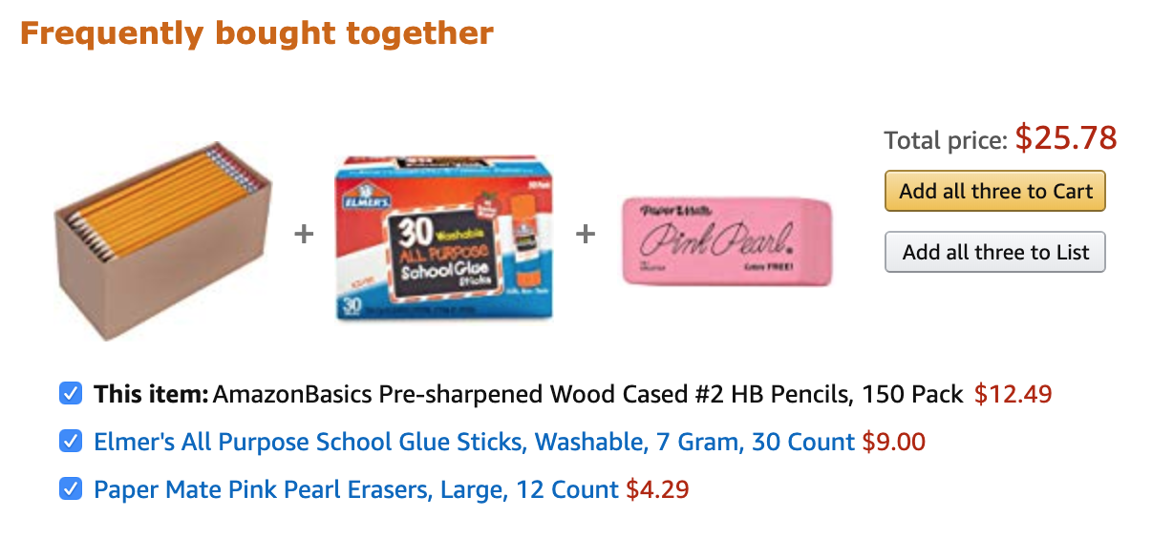
If you bought a pencil..

Slide 14
Amazon will suggest other items like glue

Slide 15
And erasers

Slide 16
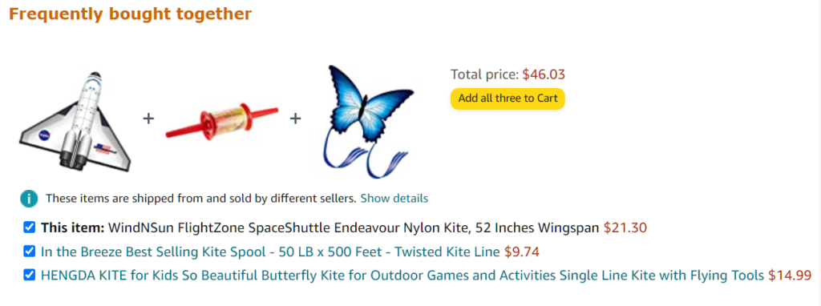
If you bought a kite..

Slide 17
It may suggest that you may like a kite spool

Slide 18
And another kite..

Slide 19
The big question is “What is the best product to propose to the customer?”

Slide 20
This is where Association Rule Learning/Market Basket Analysis comes into play.

Slide 21
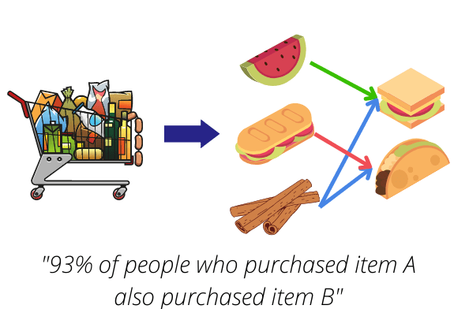
Association Rule Learning
Is a rule-based unsupervised machine learning method for discovering relations between variables in large datasets.

Slide 22
Association Rule Learning
The goal is to identify strong relations discovered in datasets using some measures such as support, confidence and lift.

Slide 23
Association Rule Learning
Its provides an answer to the question:
How likely is that customer will buy product A if he or she already has product B in their cart

Slide 24
Association Rule Learning
So it gives you an answer to the question:
Which products are often bought together?

Slide 25
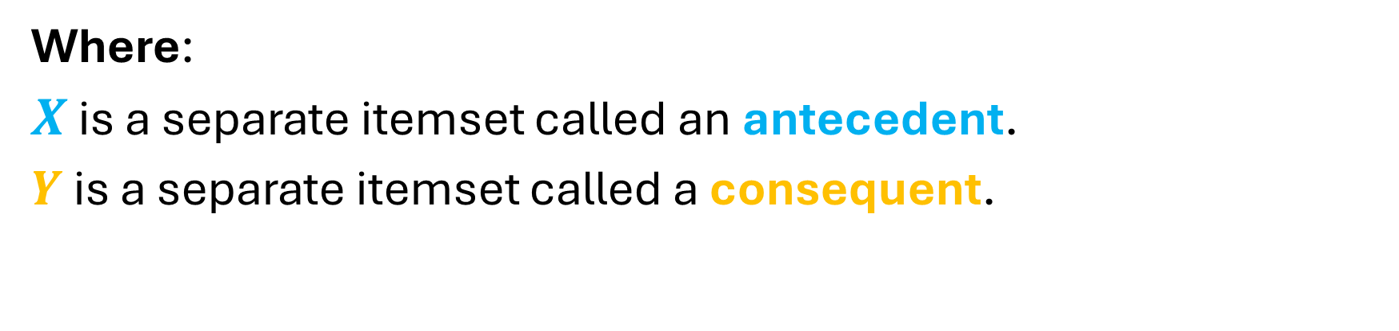

Association Rule Learning
$$X ⟹Y$$
Where:
$X$ is a separate itemset called an antecedent.
$Y$ is a separate itemset called a consequent.

Slide 26

$$bread ⟹milk$$
For example, if we have an association rule
“If a customer buys bread, he is 70% likely to buy milk”
Bread is the antecedent and milk is the consequent.

Slide 27
Association Rule Learning
All data used in this technique is categorical.
There is no dependent variable.
It input it accepts are mostly raw point-of-sale transaction data.
The output produced is the description of the most frequent relationship among variables.

Slide 28
Algorithms for generating Association Rules
Apriori
Algorithm
Eclat
Algorithm
FP-growth
Algorithm

Slide 29
Business Applications
In online retail, association rule may suggest not to put one item on sale at a time and instead to create a bundle of products promoted as a package to sell other non-selling items.

Slide 30
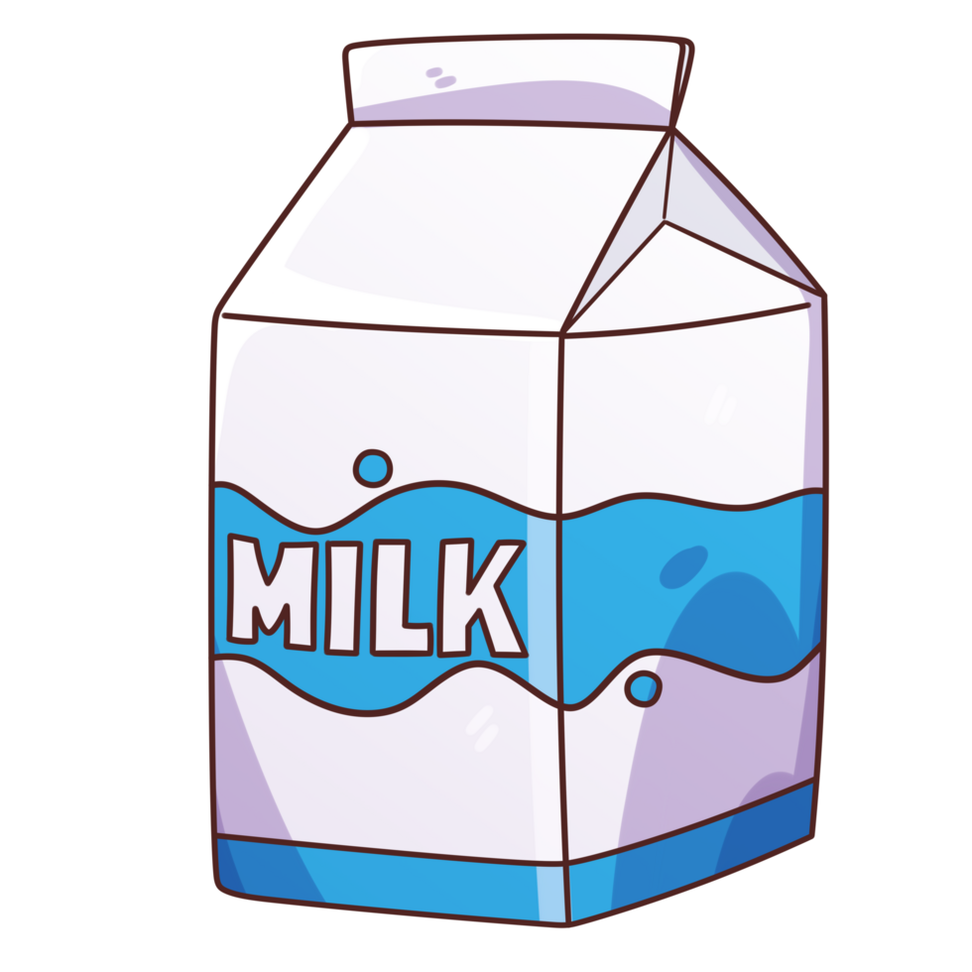



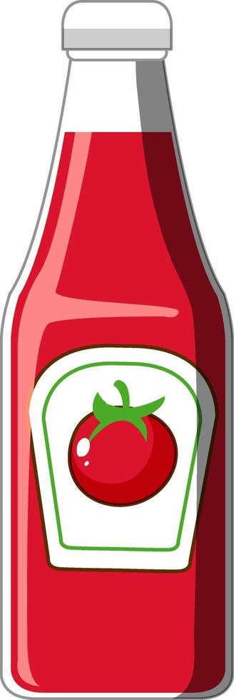

1
2
3
4
5
6
7
8
9
10
11
12

Slide 31
Transaction | Milk | Egg | Bread | Butter | Ketchup | Cookies
1 | 1 | 1 | 1 | 1 | 0 | 0
2 | 1 | 1 | 0 | 1 | 1 | 0
3 | 0 | 0 | 1 | 1 | 1 | 0
4 | 1 | 0 | 1 | 1 | 0 | 0
5 | 0 | 0 | 1 | 1 | 0 | 1
6 | 1 | 0 | 1 | 1 | 0 | 1
7 | 1 | 0 | 0 | 0 | 0 | 1
8 | 1 | 0 | 1 | 1 | 0 | 0
9 | 0 | 1 | 1 | 1 | 0 | 1
10 | 1 | 0 | 1 | 1 | 0 | 0
11 | 1 | 0 | 1 | 1 | 0 | 0
12 | 1 | 0 | 1 | 0 | 1 | 1

Slide 32
Frequency
The frequency in the table of results tells us how often the products of the X and Y appear in a transaction.

Slide 33
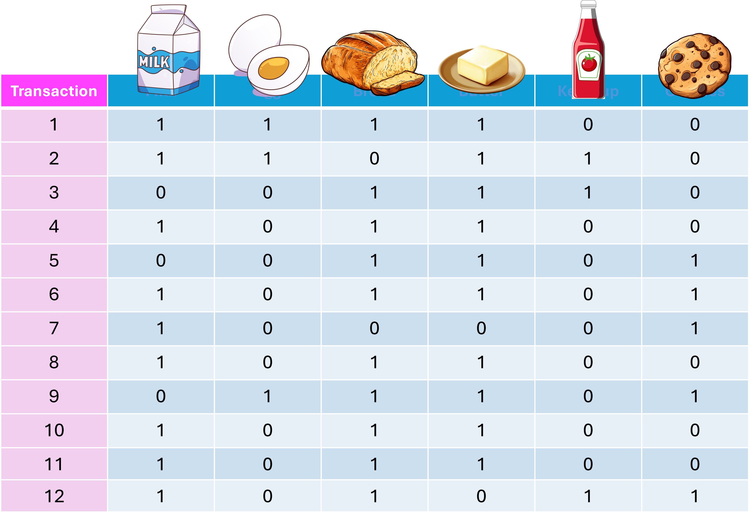
Item set | Frequency
 | 9
 | 10
 | 10
 | 3
 | 3
 | 5

Slide 34
Item set | Frequency
 | 7
 | 7
 | 3
 | 9
 | 3
 | 4

Slide 35
Item set | Frequency
 | 6
 | 1
3 | 3
 | 2

Slide 36
Support
Support is an indication of how frequently the itemset appears in the dataset.
This is an indication of how popular an item is in a dataset.

Slide 37
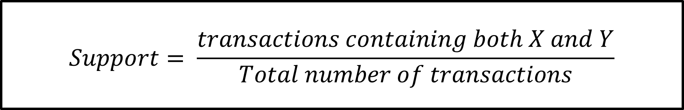
Support
$$Support= \frac{transactions containing both X and Y}{Total number of transactions}$$

Slide 38
Confidence
Confidence is an indication of how often the rule has been found to be true.
Confidence says how likely item Y is purchased when item X is purchased

Slide 39
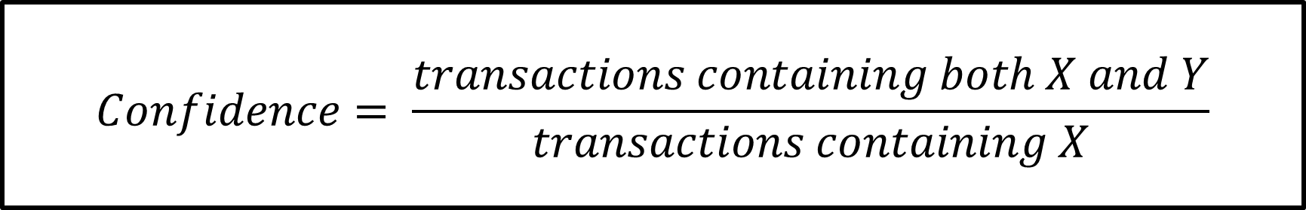
Confidence
$$Confidence= \frac{transactions containing both X and Y}{transactions containing X}$$

Slide 40
Lift
The lift indicates the factor by which the probability of buying the products under Y increases if the products under X have already been bought.

Slide 41

Confidence
$$Lift= \frac{Support}{Support X × Support Y}$$

Slide 42

Rule | Support | Confidence
 | 50% | 66.67%
 | 50% | 60.00%
 | 50% | 60.00%
 | 50% | 85.70%
 | 50% | 85.70%
 | 50% | 66.67%

Slide 43
References
https://numiqo.com/tutorial/market-basket-analysis

